Slide 1
Orientation et Formation Professionnelle
Tertiaire et Développement Informatique

Slide 2



Conception et Développement Logiciel
Intégration & Déploiement Continu (CI/CD)

Slide 3
CI/CD
La crise du logiciel
Déploiement manuel
CI : Intégration Continue
CD : Déploiement Continu
CI/CD : DevOps

Slide 4
Un peu d’histoire
1

Slide 5
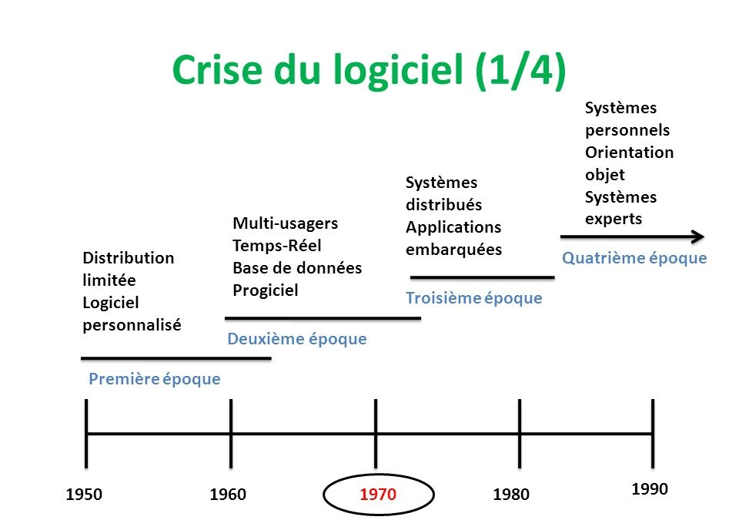
2, Histoire

Slide 6
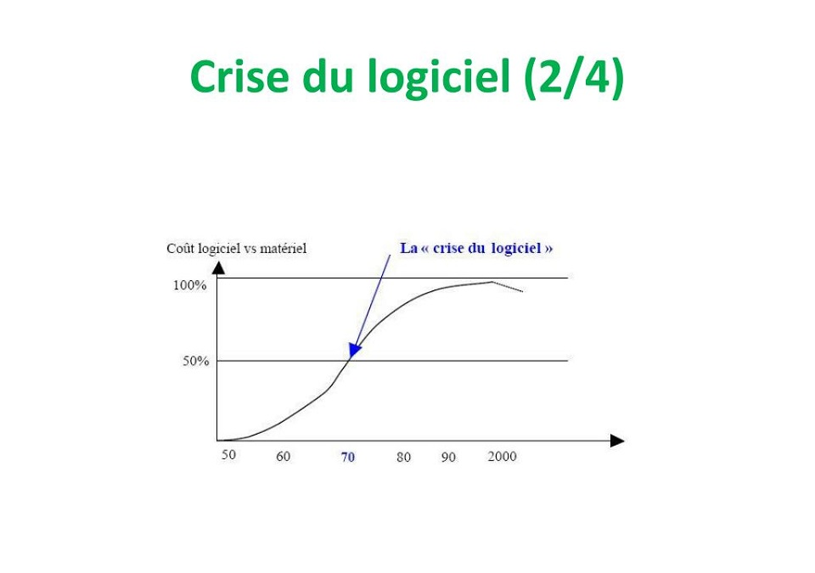
2, Histoire

Slide 7
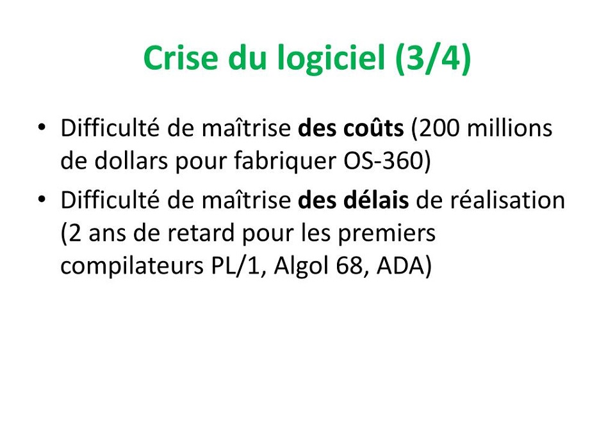
2, Histoire

Slide 8
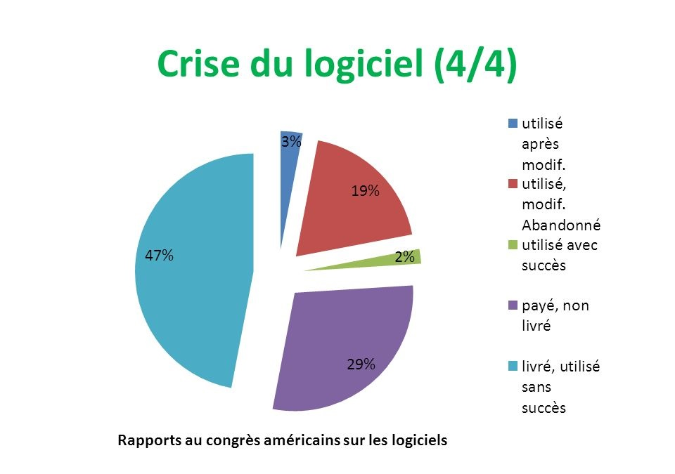
2, Histoire

Slide 9
Déploiement manuel
2

Slide 10
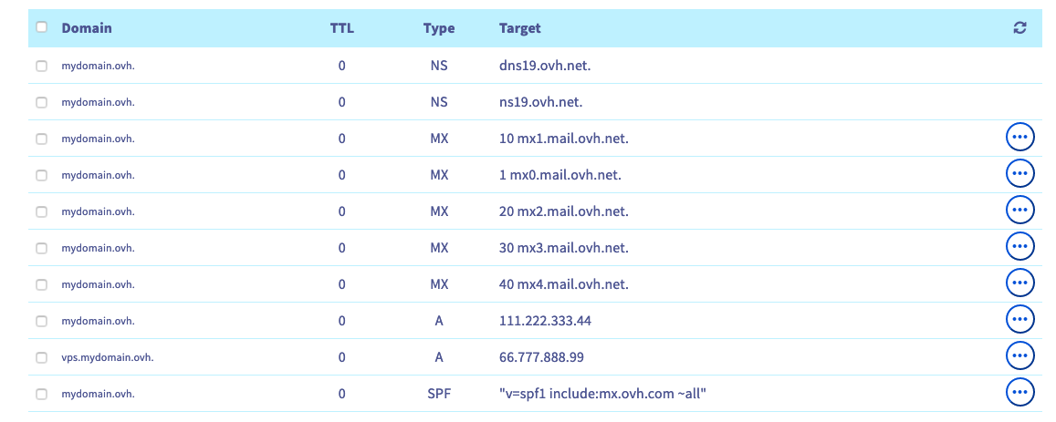
2, Histoire

Slide 11
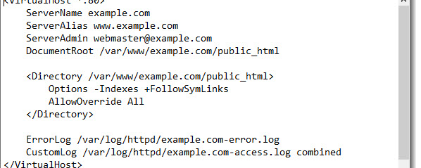
2, Histoire

Slide 12
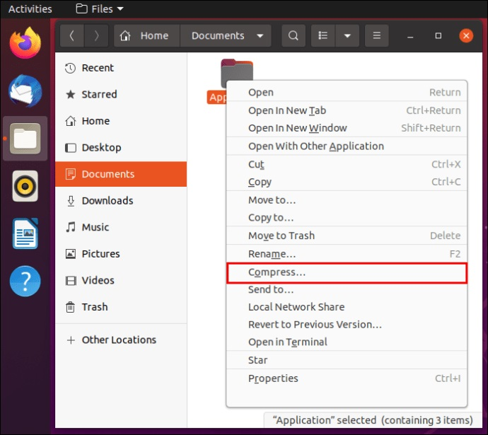
2, Histoire

Slide 13
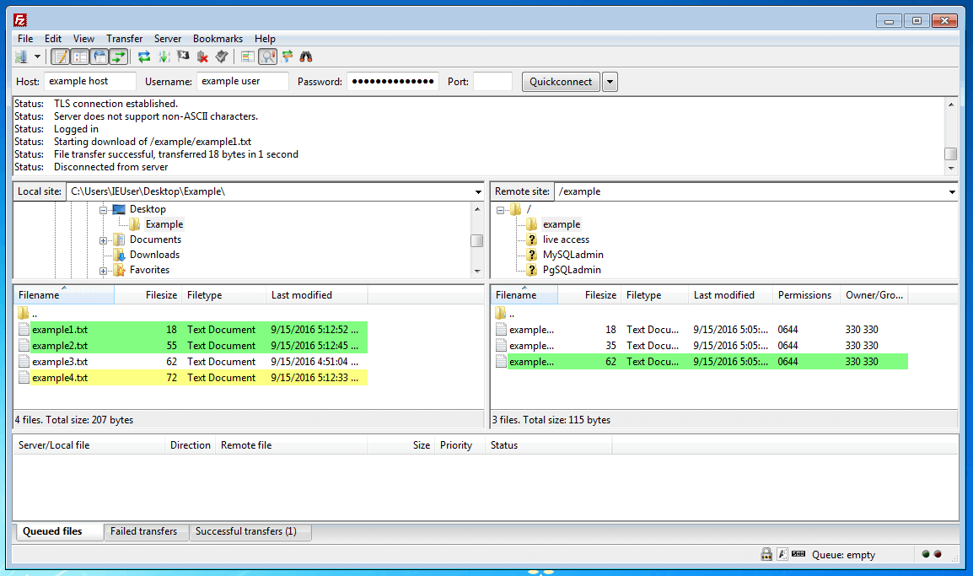
2, Histoire

Slide 14
L’intégration Continue
2

Slide 15
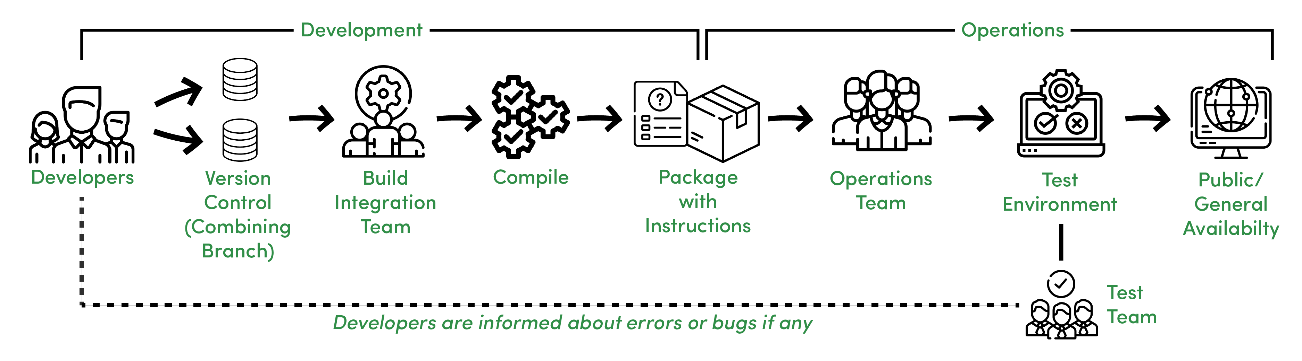
2, CI

Slide 16
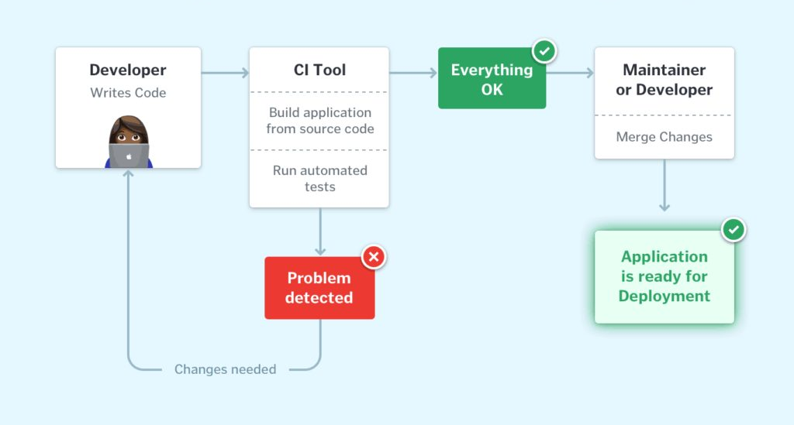
2, CI

Slide 17
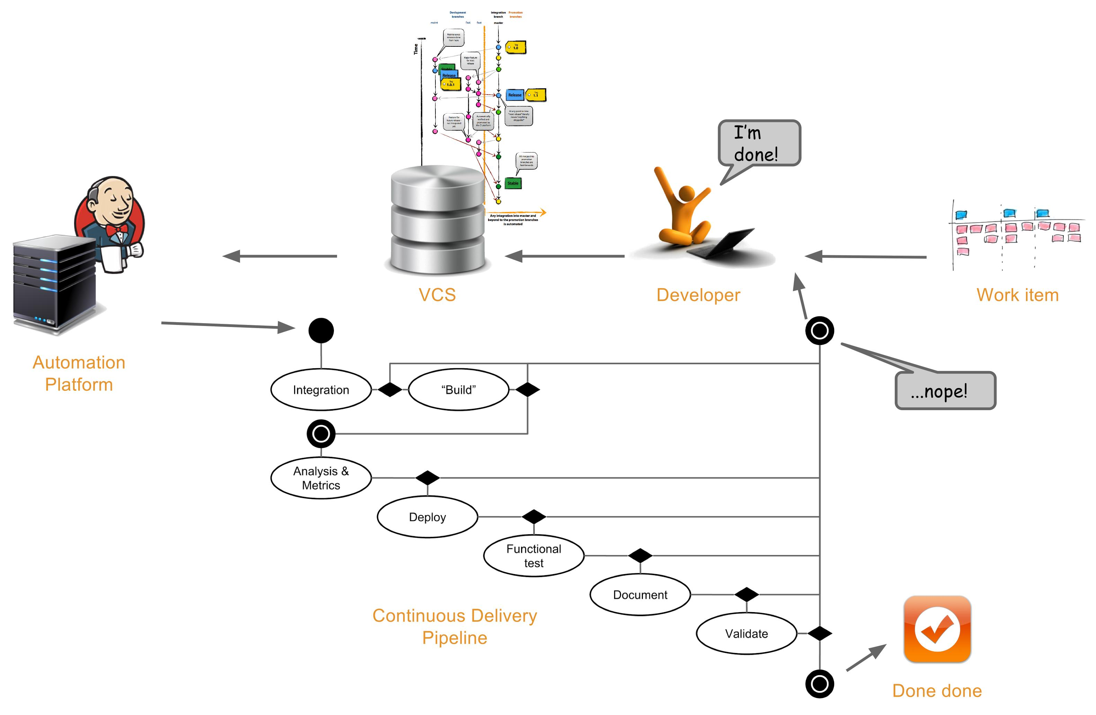
4. CI/CD DevOps

Slide 18
Le Déploiement Continu
3

Slide 19
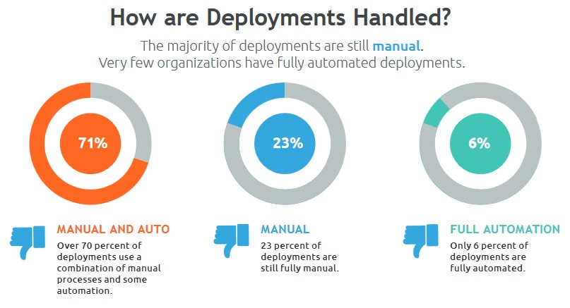
3, CD

Slide 20
3. CD

Slide 21
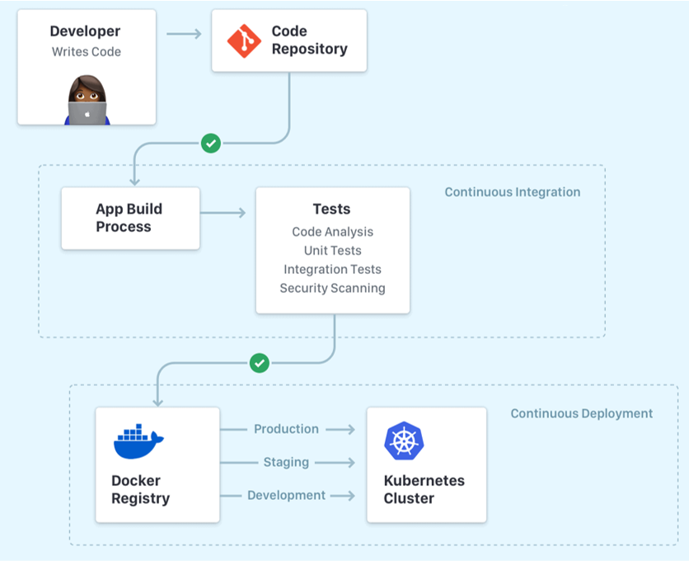
3, CD

Slide 22
CI/CD : L’approche DevOps
3

Slide 23
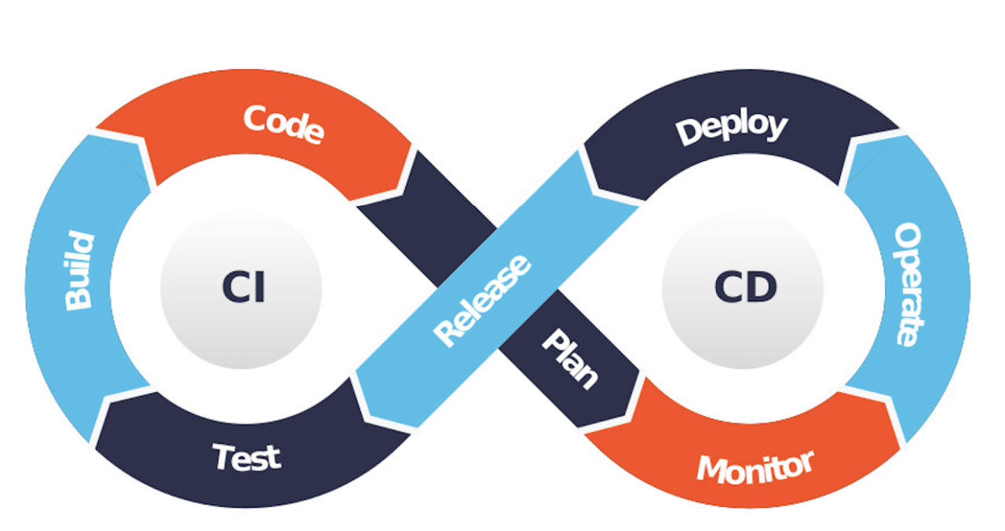
4. CI/CD DevOps

Slide 24
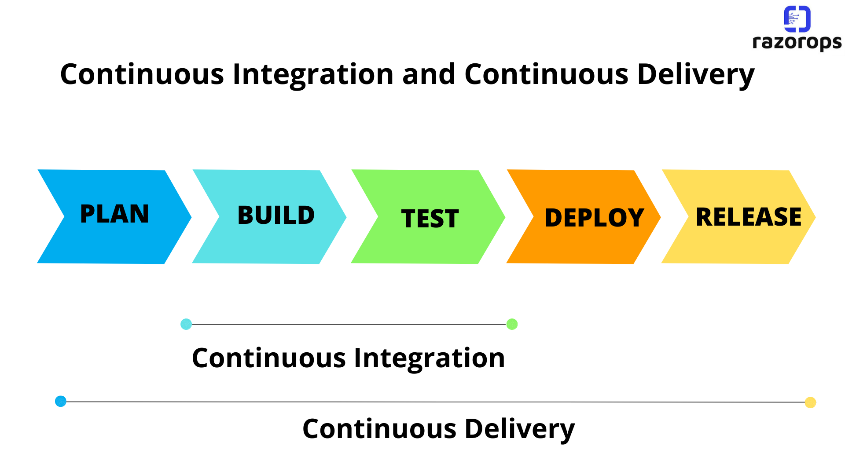
4. CI/CD DevOps

Slide 25
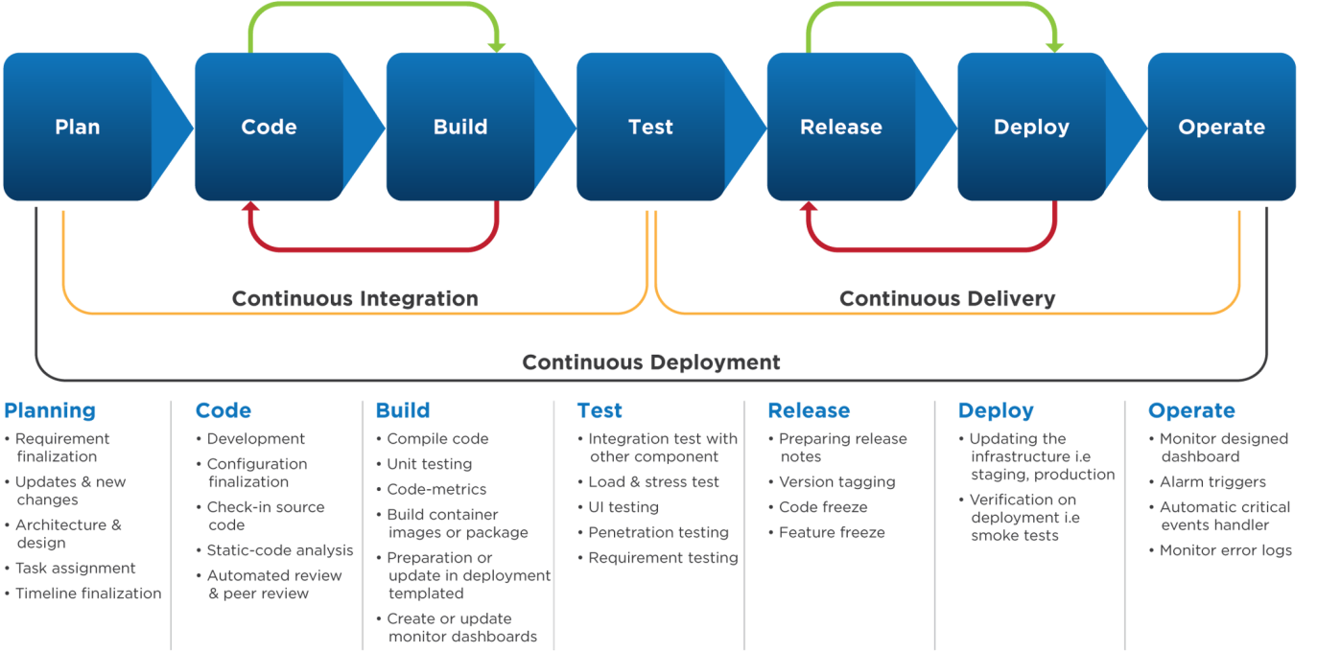
4. CI/CD DevOps

Slide 26
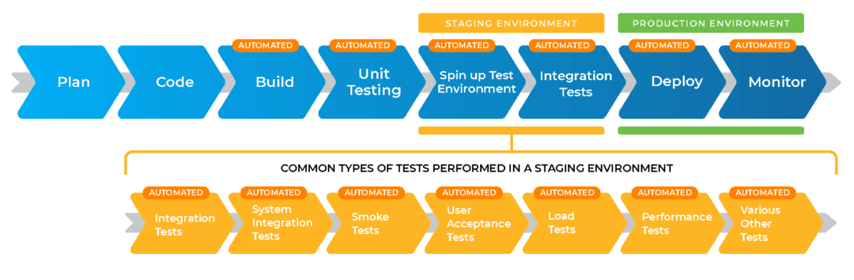
4. CI/CD DevOps

Slide 27
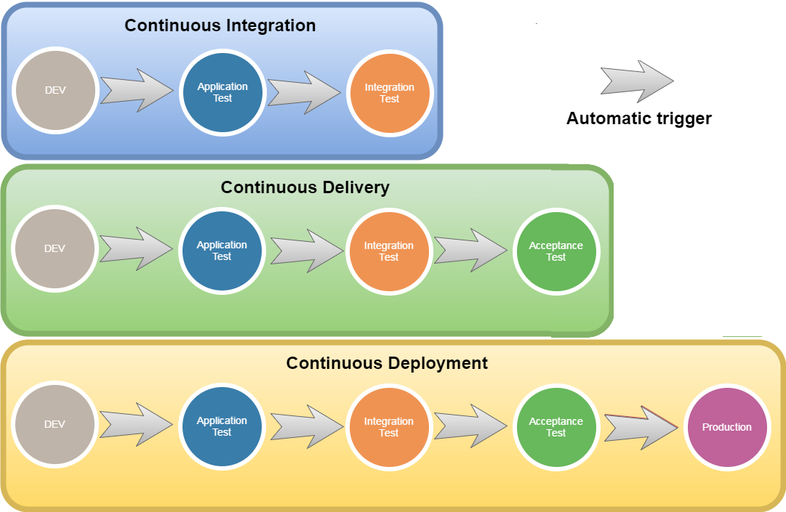
4. CI/CD DevOps

Slide 28

1. NOM DU CHAPITRE
Titre de la page
Powder jelly cheesecake ice cream sweet macaroon chocolate cake donut tootsie roll. Marzipan lemon drops macaroon liquorice soufflé halvah. Chocolate bar tiramisu pastry topping jelly-o sesame snaps sweet roll. Marshmallow carrot cake cake candy canes dessert.
Jelly ice cream bear claw sweet cupcake candy canes. Lollipop chocolate oat cake chocolate bar wafer gummies. Wafer sesame snaps muffin pastry dragée.
Lemon drops gummi bears candy canes. Gummi bears gummi bears pudding bonbon toffee brownie icing. Icing jelly liquorice sweet topping chocolate croissant gummi bears bear claw.
Liquorice danish pastry oat cake danish danish cookie cake. Chupa chups lemon drops ice cream pastry ice cream cake cupcake chocolate bar. Wafer dragée candy sesame snaps cheesecake fruitcake gingerbread jujubes jelly-o.

Slide 29



1. NOM DU CHAPITRE
Titre de la page
Powder jelly cheesecake ice cream sweet macaroon chocolate cake donut tootsie roll. Marzipan lemon drops macaroon liquorice soufflé halvah. Chocolate bar tiramisu pastry topping jelly-o sesame snaps sweet roll. Marshmallow carrot cake cake candy canes dessert.
Jelly ice cream bear claw sweet cupcake candy canes. Lollipop chocolate oat cake chocolate bar wafer gummies. Wafer sesame snaps muffin pastry dragée. Caramels marzipan chocolate. Marshmallow carrot cake macaroon cookie. Chocolate cake cake gingerbread. Bonbon icing gummies sweet apple pie. Jelly ice cream bear claw sweet cupcake candy canes. Lollipop chocolate oat cake chocolate bar wafer gummies. Wafer sesame snaps muffin pastry dragée.
Jelly ice cream bear claw sweet cupcake candy canes
Jelly ice cream b Lollipop chocolate oat cake chocolate bar wafer gummies. Wafer sesame snaps.
Jelly ice cream bear claw sweet cupcake candy canes

Slide 30

1. NOM DU CHAPITRE
Titre de la page
Powder jelly cheesecake ice cream sweet macaroon chocolate cake donut tootsie roll. Marzipan lemon drops macaroon liquorice soufflé halvah. Chocolate bar tiramisu pastry topping jelly-o sesame snaps sweet roll. Marshmallow carrot cake cake candy canes dessert
Jelly ice cream bear claw sweet cupcake candy canes. Lollipop chocolate oat cake chocolate bar wafer gummies.
Jelly ice cream bear claw sweet cupcake candy canes. Lollipop chocolate oat cake chocolate bar wafer gummies.
Jelly ice cream bear claw sweet cupcake candy canes. Lollipop chocolate oat cake chocolate bar wafer gummies.
Jelly ice cream bear claw sweet cupcake candy canes. Lollipop chocolate oat cake chocolate bar wafer gummies.

Slide 32
2

